Slide 1
GOFUNDME CAMPAIGN
Radio Mysteries
Investing in a Faster, More Reliable Online Radio Platform
70 / 78
10.0s
< 2.0s
Mobile / Desktop
Performance Score Today
Slowest Real Load Time
Measured (Mobile LCP)
Target Load Time
Mobile & Desktop
radiomysteries.com
01

Slide 2
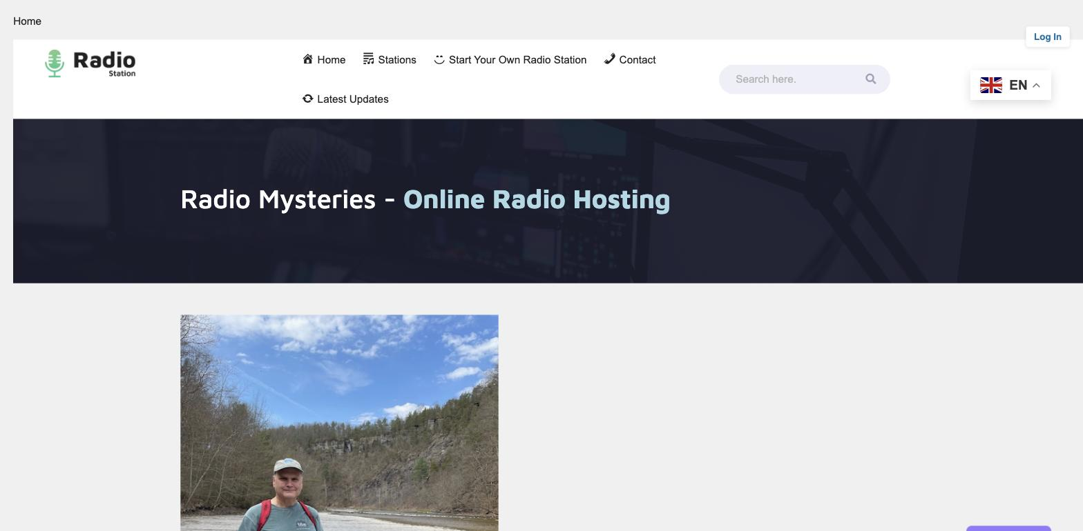
What Radio Mysteries Is
Radio Mysteries is a self-built, WordPress-based hosting platform that lets creators launch and run their own branded internet radio stations — complete with custom station pages, song request tools, listener accounts, and search-friendly navigation, all engineered in-house.
Flagship station “Dance Your Ass Off Radio” live 24/7
Custom listener accounts, station signup & song requests
SEO breadcrumbs and sitemaps generated automatically
The Radio Mysteries homepage, live today
02

Slide 3
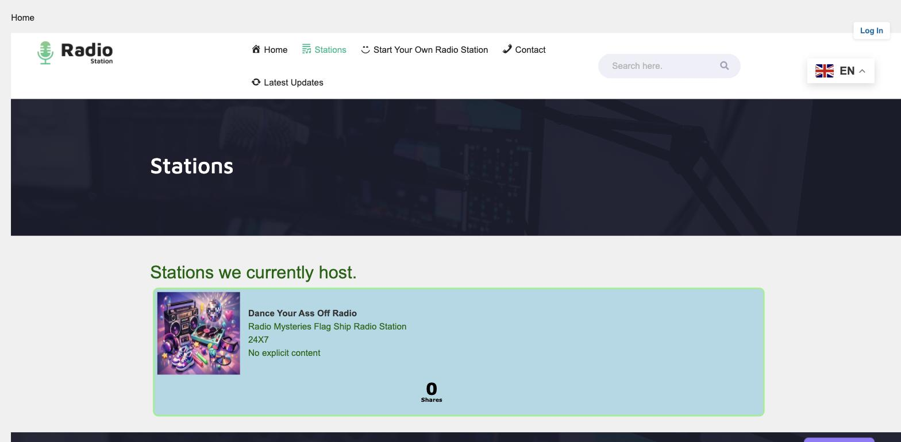
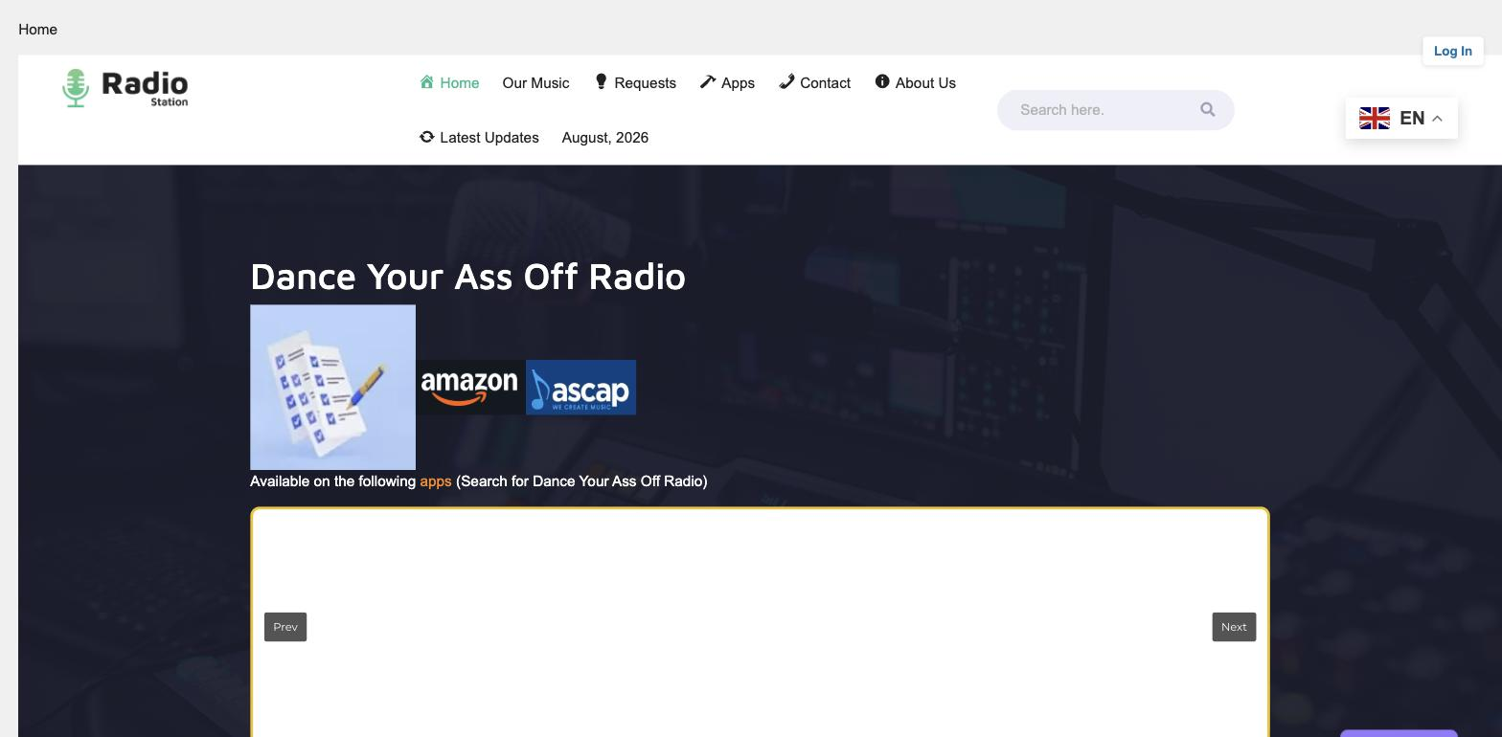
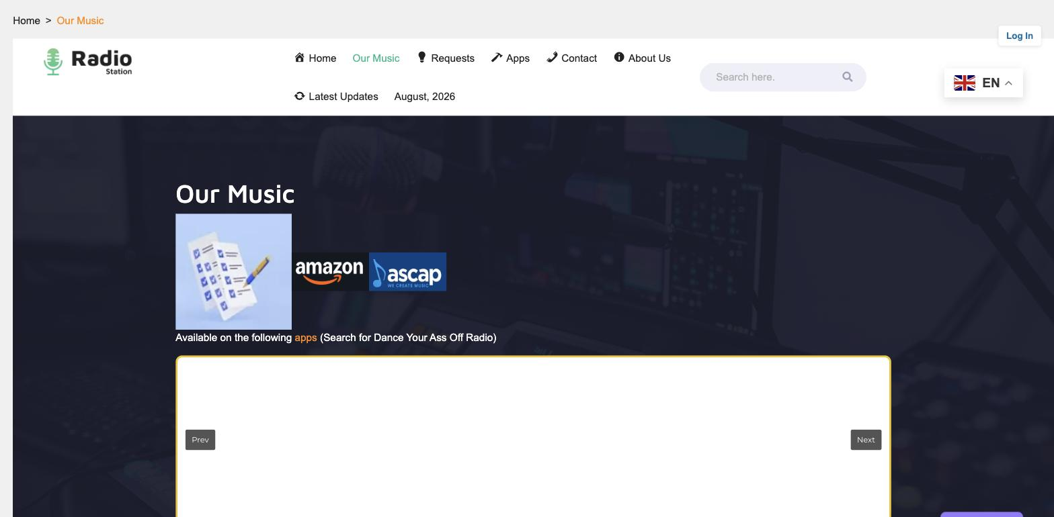
Built and Maintained In-House
Every page below — the station directory, individual station sites, and dynamic breadcrumb navigation — was custom-built for this platform.
Stations directory
“Dance Your Ass Off Radio” station page
Auto-generated breadcrumb navigation
03

Slide 4
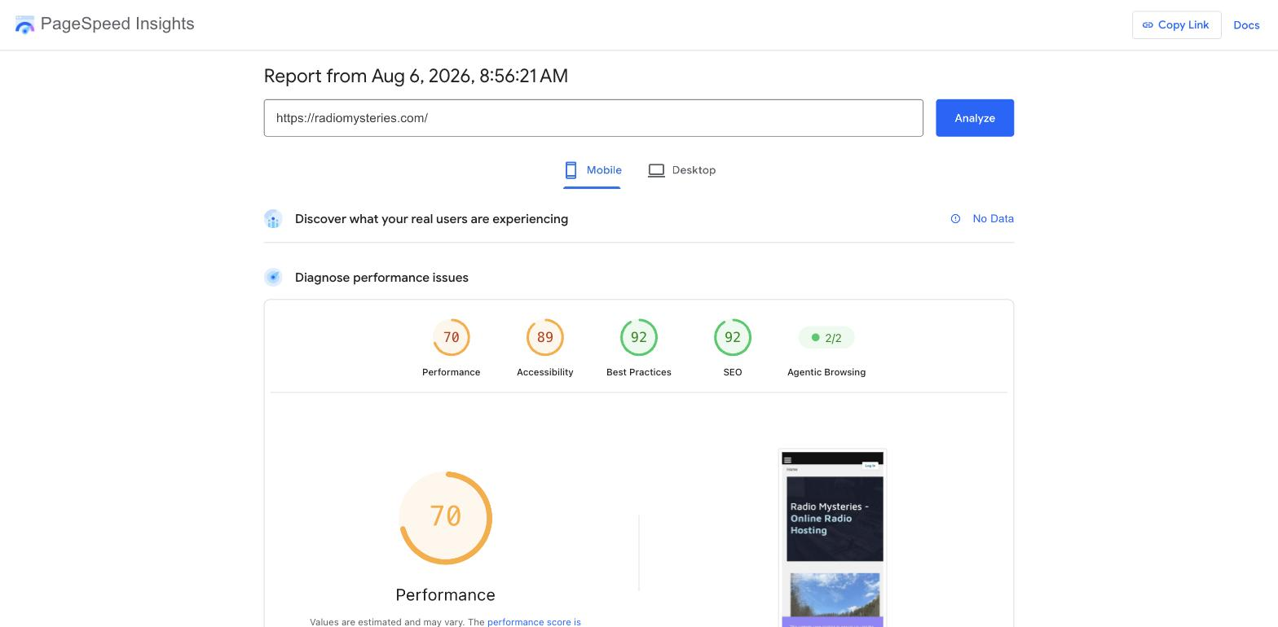
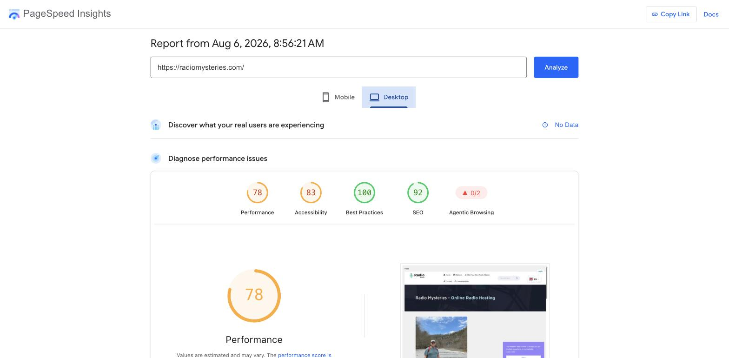
The Problem: Google Says We're Too Slow
Google PageSpeed Insights report — radiomysteries.com — August 6, 2026
Mobile
Desktop
70 / 100
78 / 100
10.0s
0.195
Mobile Performance
Desktop Performance
Mobile Largest Contentful Paint
Desktop Layout Shift (CLS)
04

Slide 5
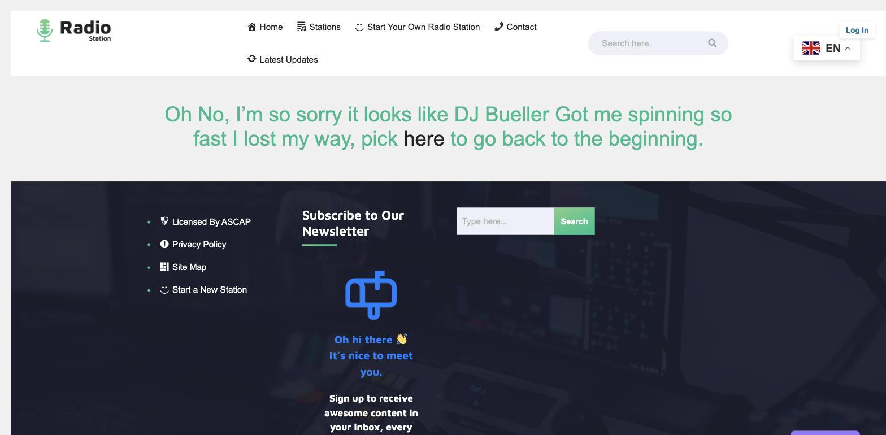
We Catch Issues Fast — And Fix Them
We audited the site's Google sitemap, found two dead links, and shipped the fix the same day.
BEFORE — Aug 6, 2026
AFTER — FIXED
/add-a-station/
Both broken entries were removed from the sitemap and every remaining URL was re-verified against the live site.
Returned a hard 404 error, but was still listed in the sitemap Google crawls.
/about-us/
Silently redirected visitors to the homepage instead of its own content.
13 / 13
sitemap URLs verified working — 100%
This fix took one afternoon. A full professional audit across every station, page, and asset — plus ongoing monitoring — is the kind of systematic work this campaign funds.
What visitors saw at /add-a-station/
05

Slide 6
The Goal
Four measurable outcomes this campaign will fund
< 2.0s
Good
0
100%
Load Time
Core Web Vitals
Broken Links
Organized
Mobile and desktop PageSpeed Insights load times both under 2 seconds.
Largest Contentful Paint and Layout Shift both rated “Good” by Google, on mobile and desktop.
Every URL in the sitemap and navigation resolves to real, working content.
A clear, consistent site structure that's easy for visitors and search engines to navigate.
06

Slide 7
Where the Funding Goes
GOAL: $1,300
Funds raised go directly toward professional testing and hands-on engineering work — not general expenses.
01
Performance Engineering
Image optimization, caching, and hosting/server tuning to bring load times under 2 seconds and move Largest Contentful Paint (LCP) and Layout Shift (CLS) into Google's “Good” range on mobile and desktop.
02
Full Site Link Audit
A systematic crawl and repair of every internal link, redirect, and sitemap entry across the platform.
03
Navigation & UX Review
A professional review of site structure and menus so visitors and search engines can find content easily.
04
Ongoing Monitoring
Recurring PageSpeed and uptime checks to keep the site fast and reliable after launch.
07

Slide 8
Help Us Build a Faster, More Reliable
Radio Mysteries
Every contribution goes directly toward professional performance testing, link repair, and navigation improvements.
$1,300
CAMPAIGN GOAL
Support the Campaign
gofundme.com/f/help-optimize-my-website-for-launch
radiomysteries.com • jhainesiii722@gmail.com
08

